Slide 1


<Victor Cruz>
<02/02/2025>

Slide 2

Outline
Executive Summary : (3)
Introduction : (4)
Methodology : (5)
Results : (16)
Conclusion : (45)
Appendix : (46)

Slide 3
Executive Summary
Summary of methodologies :
Gathering data from SpaceX public API and SpaceX Wikipedia page.
Creating the "class" label column that classifies successful landings.
Data exploration using SQL, visualization, folium maps. Collecting relevant columns to use as features.
Casting all categorical variables to binary using one-hot encoding. Data standardization and use of GridSearchCV.
Summary of all results :
Machine learning models used: Logistic regression, Support vector machine, Decision tree classifier, and K-nearest neighbors.
All models over-predicted successful landings with an accuracy rate of approximately 83.33%.

Slide 4
Introduction
Project background and context :
SpaceY wants to lead and compete with SpaceX.
SpaceX has more capital and better prices.
Problems you want to find answers :
We create and train a machine learning model to predict successful stage recovery.

Slide 5

Section 1

Slide 6
Methodology
Executive Summary
Data collection methodology:
Gathering data from SpaceX API and SpaceX Wikipedia
Perform data wrangling
We classify successful and unsuccessful landings
Perform exploratory data analysis (EDA) using visualization and SQL
Perform interactive visual analytics using Folium and Plotly Dash
Perform predictive analysis using classification models
How to build, tune, evaluate classification models

Slide 7
Data Collection
Describe how data sets were collected.
Data gathering is a combination of API requests from Space X public API and web scraping data from a table in Space X’s Wikipedia entry.
Flowchart of data collection from API and the flowchart of data collection from webscraping.
You need to present your data collection process use key phrases and flowcharts
Space X API Data Columns:
FlightNumber, Date, BoosterVersion, PayloadMass, Orbit, LaunchSite, Outcome, Flights, GridFins,
Reused, Legs, LandingPad, Block, ReusedCount, Serial, Longitude, Latitude.
Wikipedia Webscrape Data Columns:
Flight No., Launch site, Payload, PayloadMass, Orbit, Customer, Launch outcome, Version Booster, Booster landing, Date, Time

Slide 8
Data Collection – SpaceX API
Data collection with SpaceX API
Github:https://github.com/VictorGonTec/Data-Science-Capstone/blob/main/Main/labs-jupyter-spacex-Data%20wrangling.ipynb
Request Spacex API -> Json File + list[Launch site, Booster Version, Payload] ->
Json_normalize DataFrame to Json form -> Dictionary { of data to use } -> Convert Dictionary to DataFrame
-> Filter Data Falcon 9 only -> Imputing missing data in PayloadMass with the mean()

Slide 9
Data Collection - Scraping
Web scraping Data Collection
GitHub URL: https://github.com/VictorGonTec/Data-Science-Capstone/blob/main/Main/jupyter-labs-webscraping.ipynb
Request HTML from WIkipedia -> Beautiful Soup HTML5 parser ->Find Launch Tables rows -> Create dictionary {datasets} -> Iterate tables and extract dictionary {data entry} -> Casting dictionary {} to DataFrame.

Slide 10
Data Wrangling
Describe how data were processed
I created a training label with landing results where success = 1 and failure = 0 based on what I learned in past labs.
The result column has two components: "Mission Outcome" and "Landing Location".
New training label column "class" with a value of 1 if "Mission Outcome" is True and 0 otherwise.
GitHub URL:https://github.com/VictorGonTec/Data-Science-Capstone/blob/main/Main/jupyter-labs-spacex-data-collection-api.ipynb

Slide 11
EDA with Data Visualization
Summarize what charts were plotted and why you used those charts
Exploratory data analysis performed on the variables Flight Number, Payload Mass, Launch Site, Orbit, Class, and Year.
Flight Number vs. Payload Mass, Flight Number vs. Launch Site, Payload Mass vs. Launch Site, Orbit vs. Success Rate, Flight Number vs. Orbit, Payload vs. Orbit, and Annual Success Trend
Plots Used:
Scatter Plots,
Line Charts,
Bar Charts.
GitHub URL :https://github.com/VictorGonTec/Data-Science-Capstone/blob/main/Main/SpaceX_Machine%20Learning%20Prediction_Part_5.ipynb

Slide 12
EDA with SQL
Using bullet point format, summarize the SQL queries you performed
IBM DB2 to load the Database.
Queried using SQL Python integration.
use of multiple queries to get a better understanding of the data.
Queried information about launch site names, mission outcomes, various pay load sizes of customers and booster versions, and landing outcomes
GitHub URL: https://github.com/VictorGonTec/Data-Science-Capstone/blob/main/Main/jupyter-labs-eda-sql-coursera_sqllite.ipynb

Slide 13
Build an Interactive Map with Folium
Folium maps mark launch sites, successful and failed landings, and an example of proximity to key locations:
We also visualize successful landings in relation to location to understand why launch sites are located in those places.
GitHub URL : https://github.com/VictorGonTec/Data-Science-Capstone/blob/main/Main/Interactive%20Visual%20Analytics%20with%20Folium.ipynb

Slide 14
Build a Dashboard with Plotly Dash
Dashboard includes a pie chart and a scatter plot.
The Pie chart can be selected to show the distribution of successful landings across all launch sites and can be selected to show the success rates for individual launch sites.
The Scatter plot takes two inputs: all sites or an individual site and the payload mass on a slider and the pie chart is used to visualize the launch site success rate
GitHub URL: https://github.com/VictorGonTec/Data-Science-Capstone/blob/main/Main/spacex_dash_app.py

Slide 15
Predictive Analysis (Classification)
Split the label class column -> Fit the features with StandardScaler() ->
Train_Test_Split() the data -> Apply GridSearchCV() -> GridSearchCV() on Logisteic Regression, DecisionTree, KNigbors and SVM. -> score(Test data) -> ConfusionMatrix(All Models) -> BarPlot over all score models.
GitHub URL: https://github.com/VictorGonTec/Data-Science-Capstone/blob/main/Main/SpaceX_Machine%20Learning%20Prediction_Part_5.ipynb

Slide 16
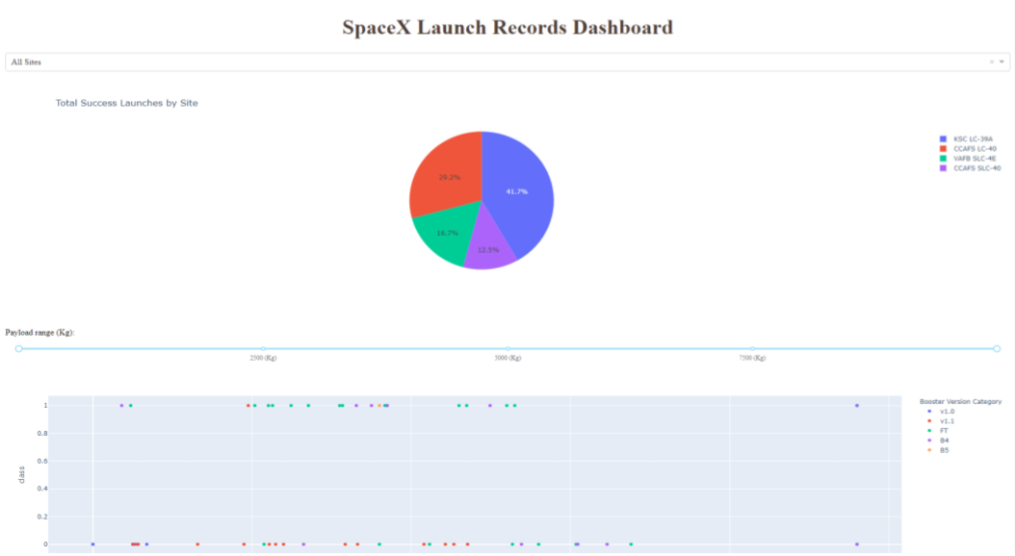
Results
Plotly Dashboard Previeu accuracy of 83.33% of de model result

Slide 17

Section 2

Slide 18
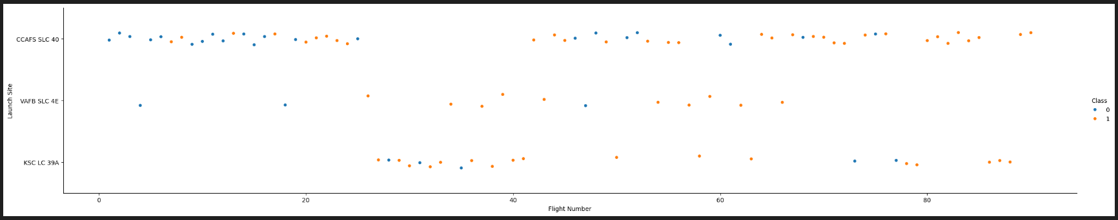
Flight Number vs. Launch Site
Blue Represent Successful launch and Orange unsuccessful launch.
Graphic suggests an increase in success rate over time (indicated in Flight Number).
CCAFS appears to be the main launch site as it has the most volume.

Slide 19
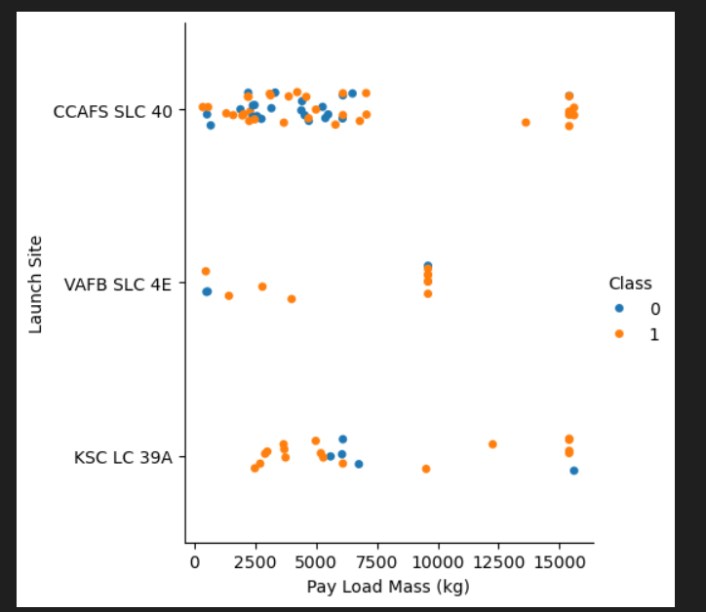
Payload vs. Launch Site
Blue Represent Successful launch and Orange unsuccessful launch.
Payload mass appears to fall mostly between 0-6000 kg.
Different launch sites also seem to use different payload mass.

Slide 20
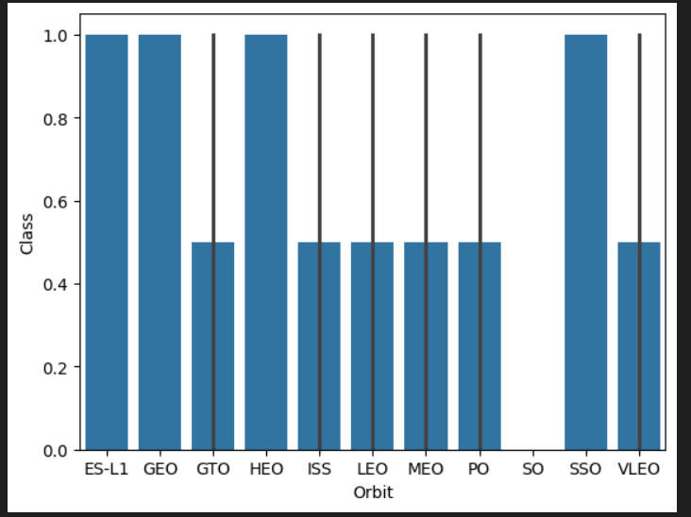
Success Rate vs. Orbit Type
ES-L1 (1), GEO (1), HEO (1) tienen una tasa de éxito del 100 % (los tamaños de muestra están entre paréntesis).
SSO (5) tiene una tasa de éxito del 100 %.
VLEO (14) tiene una tasa de éxito y unos intentos aceptables.
SO (1) tiene una tasa de éxito del 0 %.
GTO (27) tiene una tasa de éxito de alrededor del 50 %, pero la muestra más grande.

Slide 21
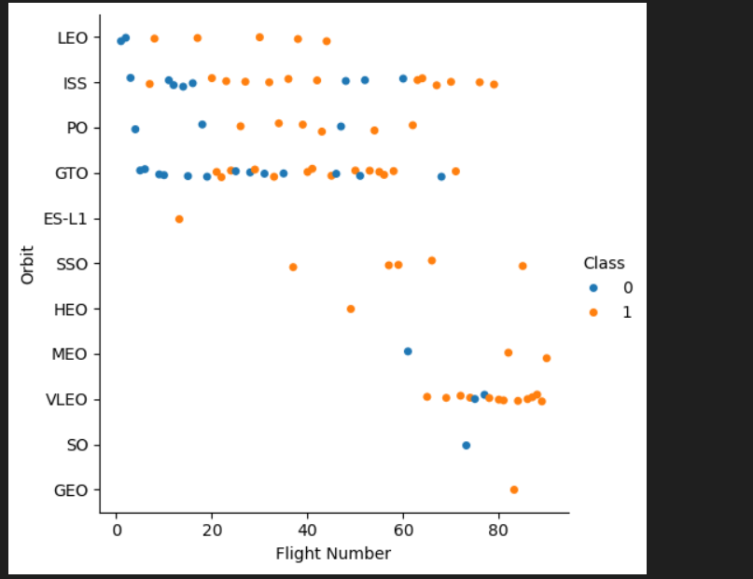
Flight Number vs. Orbit Type
Launch orbit preferences changed depending on flight number.
Launch outcome appears to be related to this preference.
SpaceX started with LEO orbits that were moderately successful and returned to VLEO in recent launches.

Slide 22
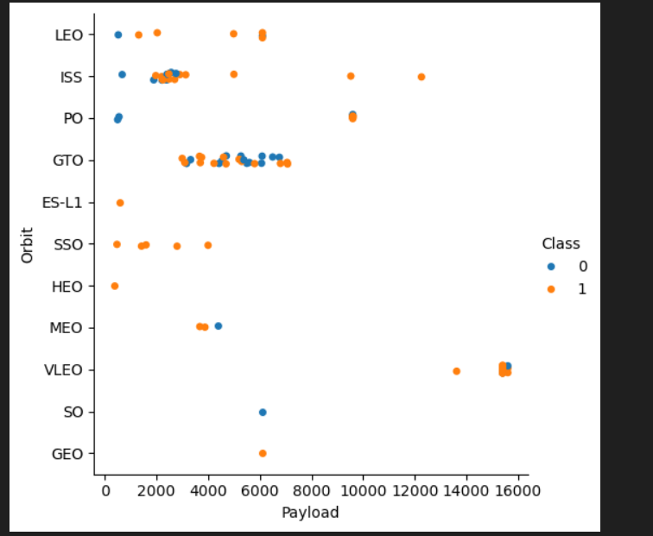
Payload vs. Orbit Type
Payload mass appears to correlate with LEO orbit.
SSO appear to have relatively low payload mass.
VLEO only has payload mass values at the high end of the range.

Slide 23
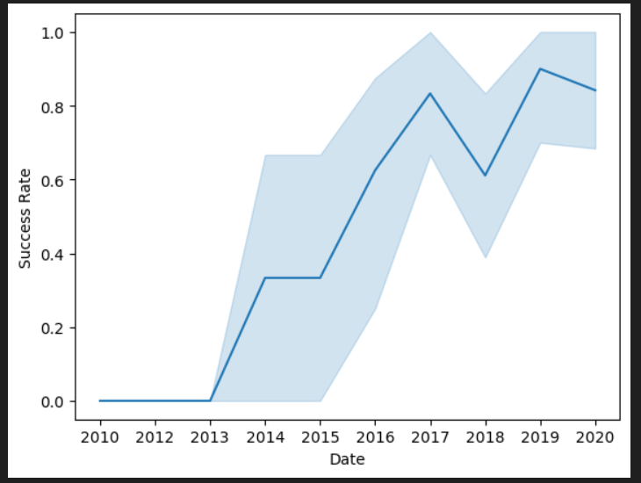
Launch Success Yearly Trend
Success in recent years around 80%.
Success generally increases over time since 2013 with a slight drop in 2018

Slide 24
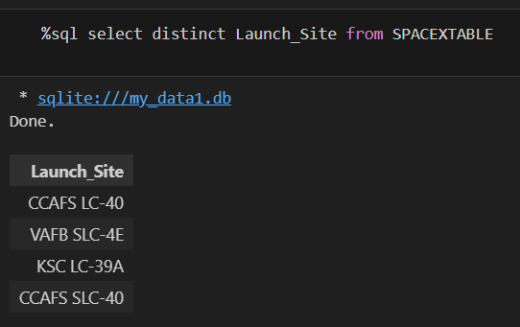
All Launch Site Names
Check the database for unique launch site names.
It is likely that CCAFS SLC-40 and CCAFSSLC-40 represent the same launch site with data entry errors.
CCAFS LC-40 was the previous name.
Most likely there are only 3 unique launch_site values:
CCAFS SLC-40, KSC LC-39A, VAFB SLC-4E

Slide 25
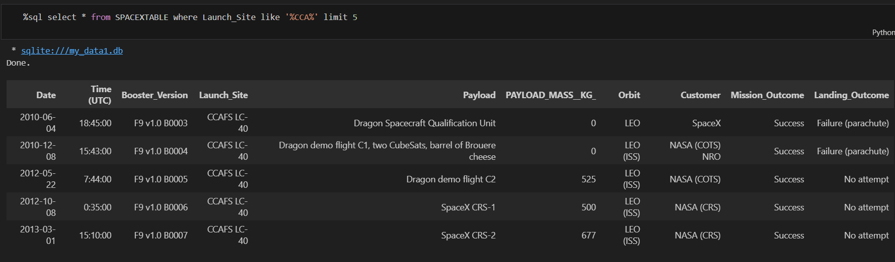
Launch Site Names Begin with 'CCA'
Find 5 records where launch sites begin with `CCA`

Slide 26
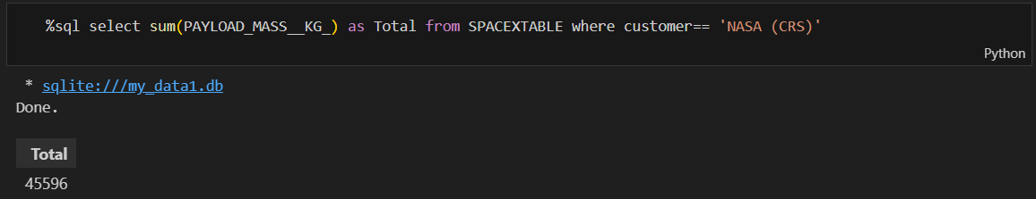
Total Payload Mass
Calculate the total payload carried by boosters from NASA
This query sums the total payload mass in kg where NASA was the customer.

Slide 27
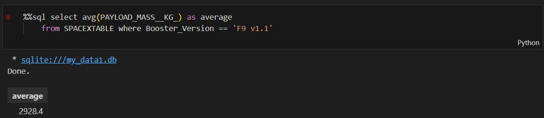
Average Payload Mass by F9 v1.1
Calculate the average payload mass carried by booster version F9 v1.1
Average payload mass of F9 1.1 is on the low end of our payload mass range

Slide 28
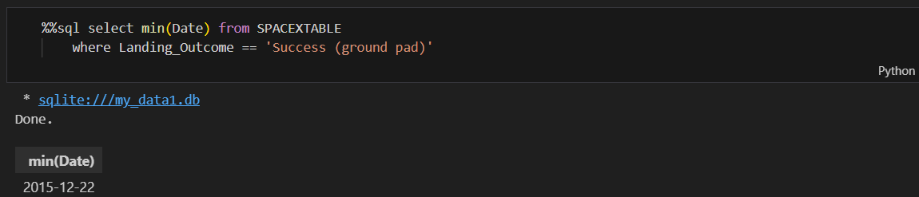
First Successful Ground Landing Date
This query returns the first successful ground pad landing date.
First ground pad landing was around 2015.
Successful landings in general appear starting 2014

Slide 29
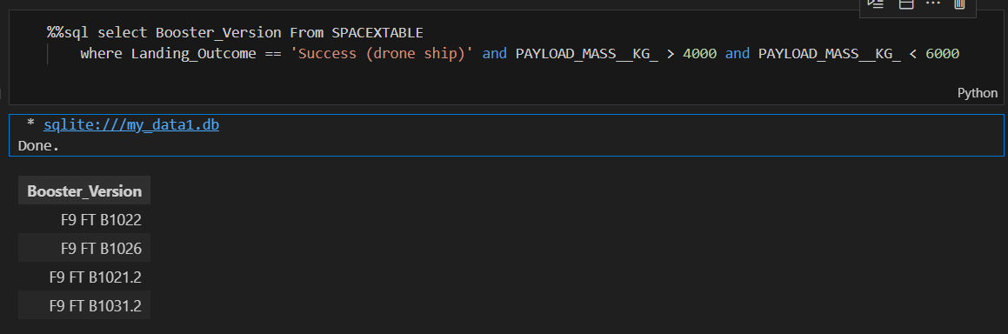
Successful Drone Ship Landing with Payload between 4000 and 6000
This query returns the four booster versions that had successful drone ship landings and a payload mass between 4000 and 6000 non inclusively.

Slide 30
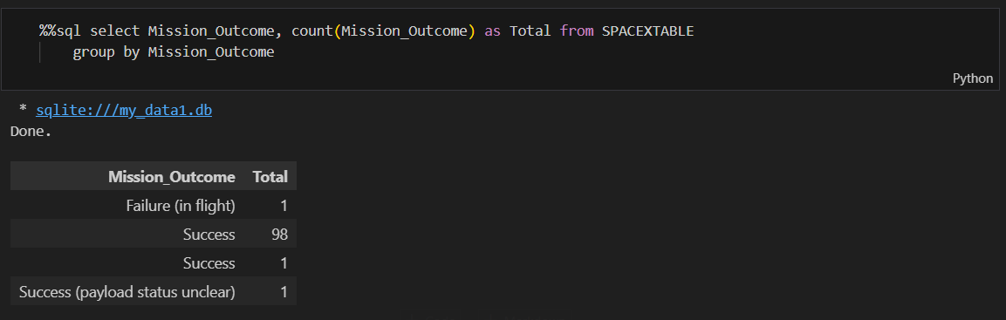
Total Number of Successful and Failure Mission Outcomes
This query returns a count of each mission outcome.
SpaceX appears to achieve its mission outcome nearly 99% of the time.
This means that most of the landing failures are intended.

Slide 31
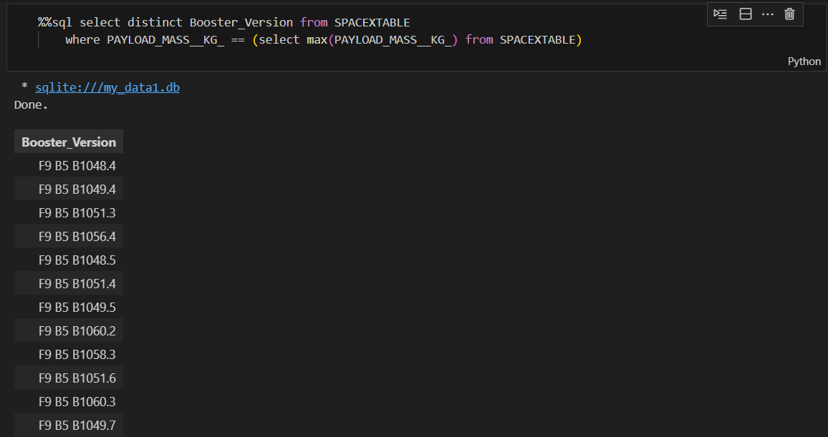
Boosters Carried Maximum Payload
This query returns the booster versions that carried the largest payload mass of 15600 kg.
These booster versions are very similar and are all of the F9 B5 B10XXX variety.

Slide 32
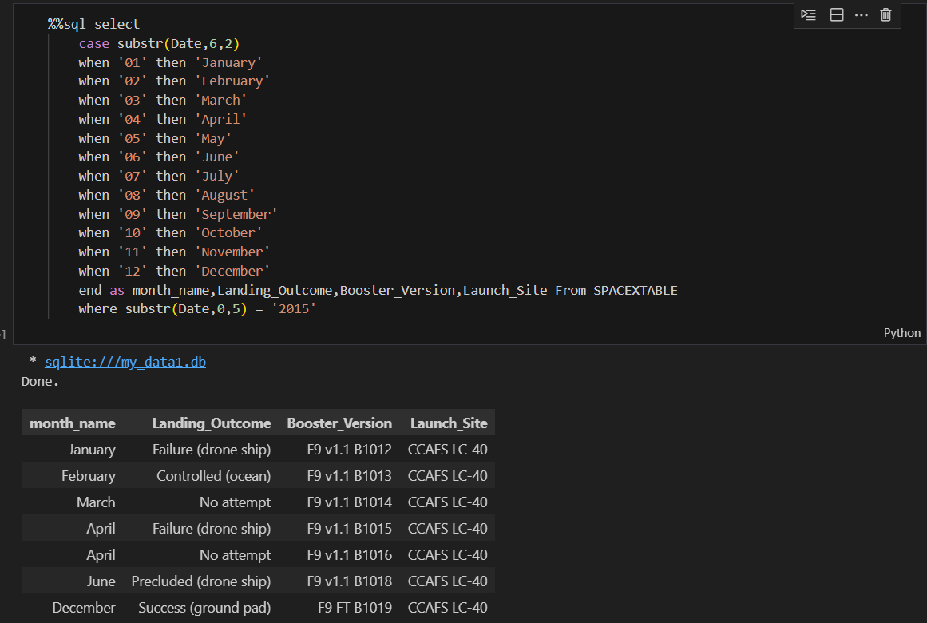
2015 Launch Records
This query represetn a list of the failed landing_outcomes in drone ship, their booster versions, and launch site names for in year 2015

Slide 33
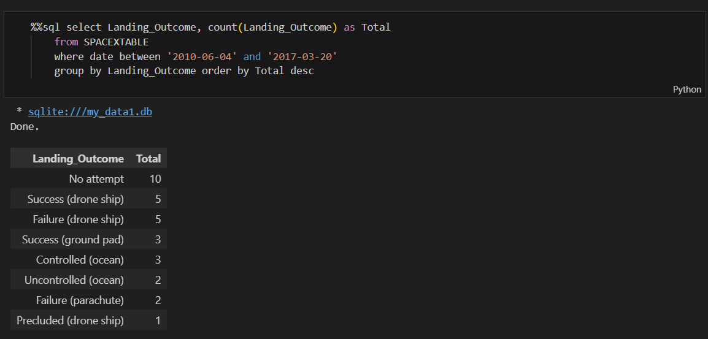
Rank Landing Outcomes Between 2010-06-04 and 2017-03-20
This is rank of the count of landing outcomes of Failure drone ship and Success ground pad between the date 2010-06-04 and 2017-03-20, in descending order

Slide 34

Section 3

Slide 35
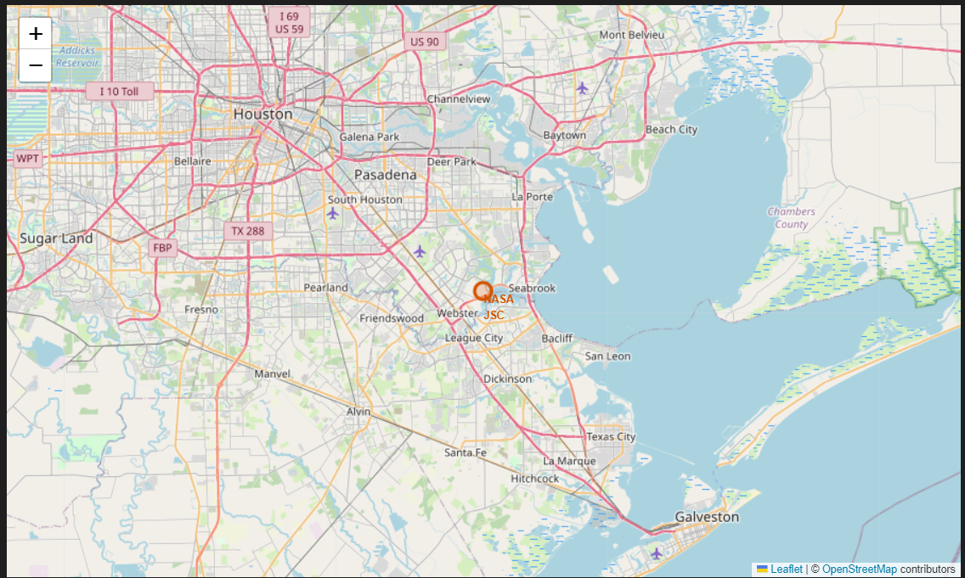
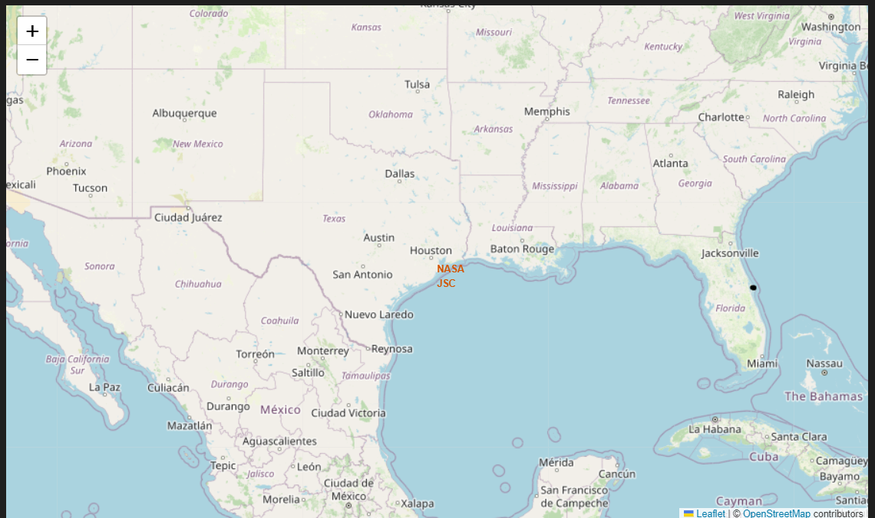
Launch Site Location
The right map shows all launch sites relative US map. The left map shows the two Houston launch sites since they are very close to each other. All launch sites are near the ocean.

Slide 36
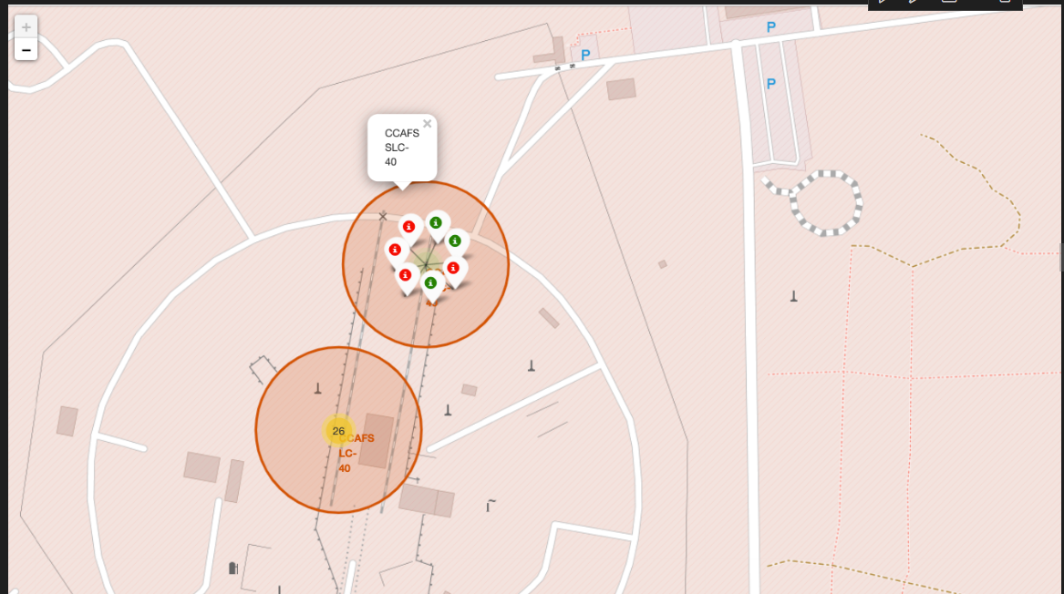
Color Marker Label
Explore the folium map and make a proper screenshot to show the color-labeled launch outcomes on the map

Slide 37
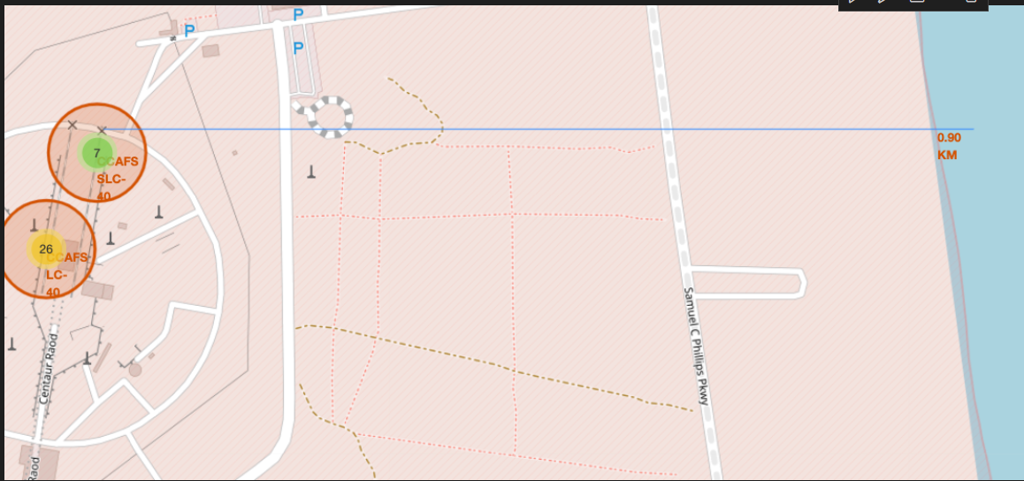
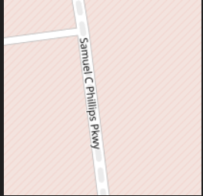

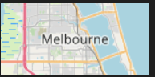
Location Proximities
Explore the generated folium map and show the screenshot of a selected launch site to its proximities such as railway, highway, coastline, with distance calculated and displayed

Slide 38

Section 4

Slide 39
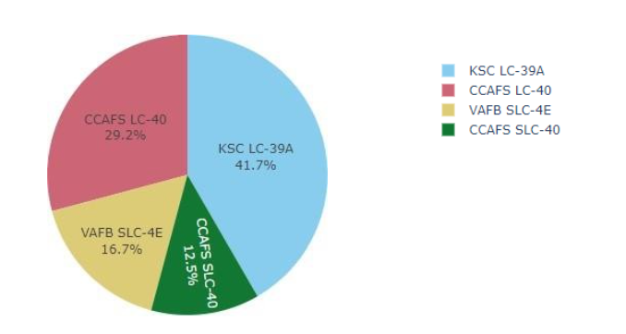
Successful Launches
This is the distribution of successful landings across all launch sites.
CCAFS LC-40 is the former name for CCAFS SLC-40.
CCAFS and KSC have the same number of successful landings.
VAFB has the lowest proportion of successful landings.

Slide 40
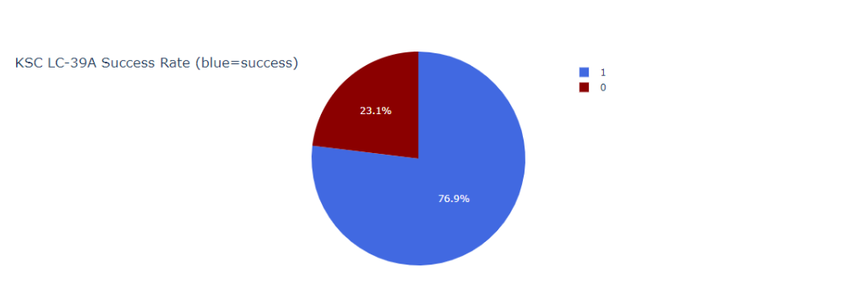
Highest Succes Launches
We can see that the KSC LC-39A has the highest success rate.
10 successful landings.
3 failed landings.

Slide 41
Payload vs Launch Outcome
We can see the relationship between Payload vs. Launch Outcome for all sites.

Slide 42

Section 5

Slide 43
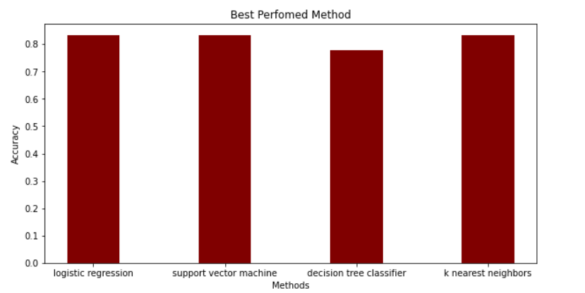
Classification Accuracy
All models have the same accuracy in the tests, with an accuracy of 83.33%.
The sample size is only 18.
This can cause a large variation in the accuracy results.

Slide 44
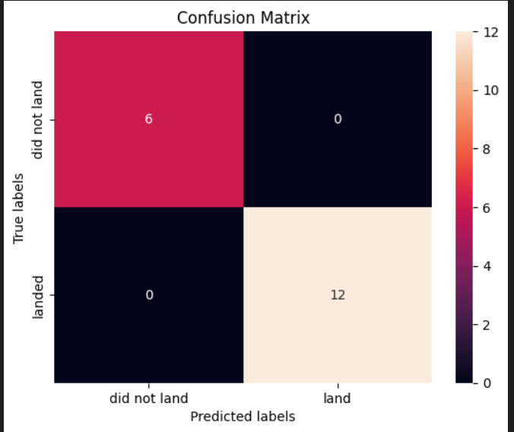
Confusion Matrix
The confusion matrix is the same for all models, because all models performed equally for the test set.
12 successful landings when the true label was successful landing.
3 failed landings when the true label was failed landing.

Slide 45
Conclusions
Point 1: We have developed a machine learning model for SpaceY, which wants to compete with SpaceX.
Point 2: Goal of the model is to predict when Stage 1 will successfully land in order to save around $100 million.
Point 3 :We have also used data from a public SpaceX API and extracted data from SpaceX's Wikipedia page.
Point 4 :We created a machine learning model with an accuracy of 83.33%
Allon Mask CEO of SpaceY can use this model to predict with relatively high accuracy whether a launch will have a successful Stage 1 landing.

Slide 46
Appendix
Github Repository URL: https://github.com/VictorGonTec/Data-Science-Capstone/tree/main/Main

Slide 47


